Slide 1
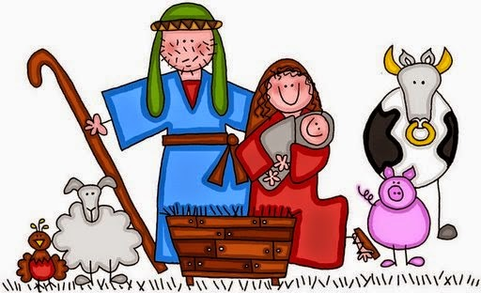
A King is Born

Slide 2
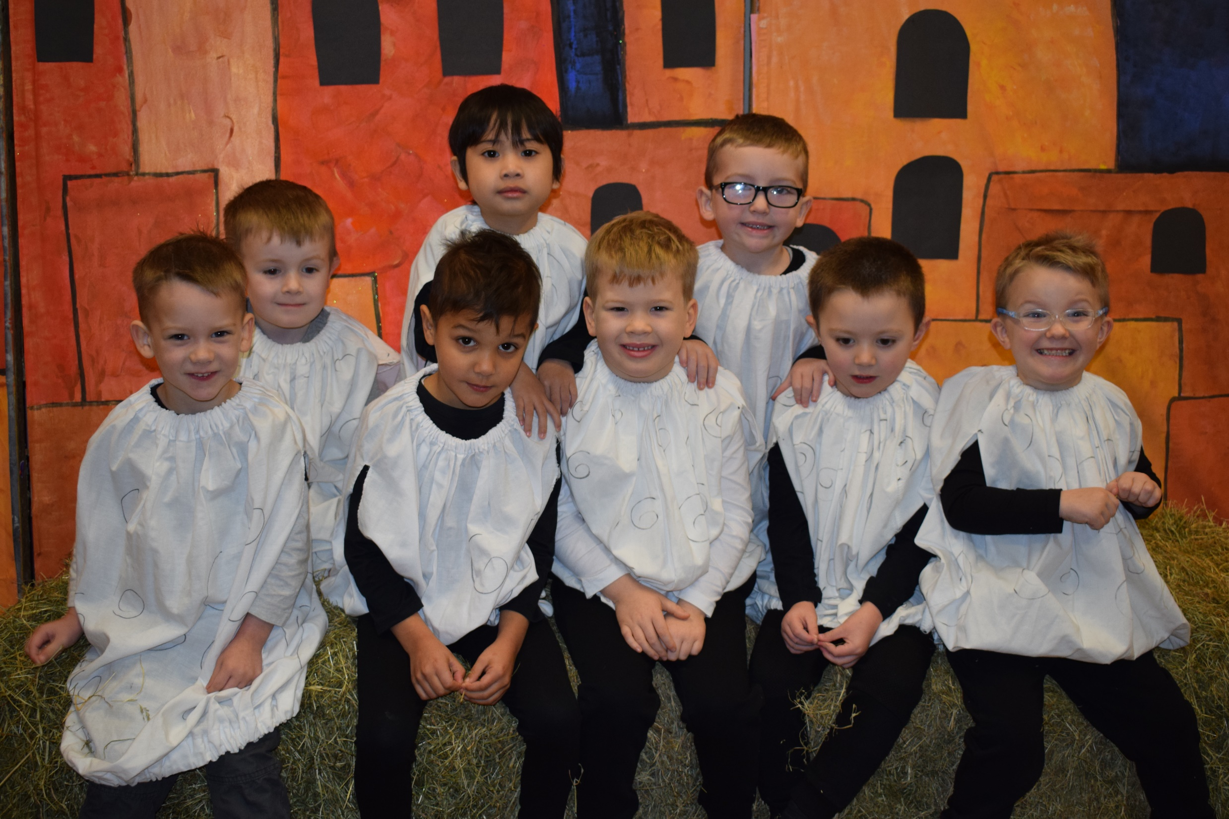
Sheep
Zack, Jayden, Saimon, Marc, Harry, Jack, Odin and Mason

Slide 3
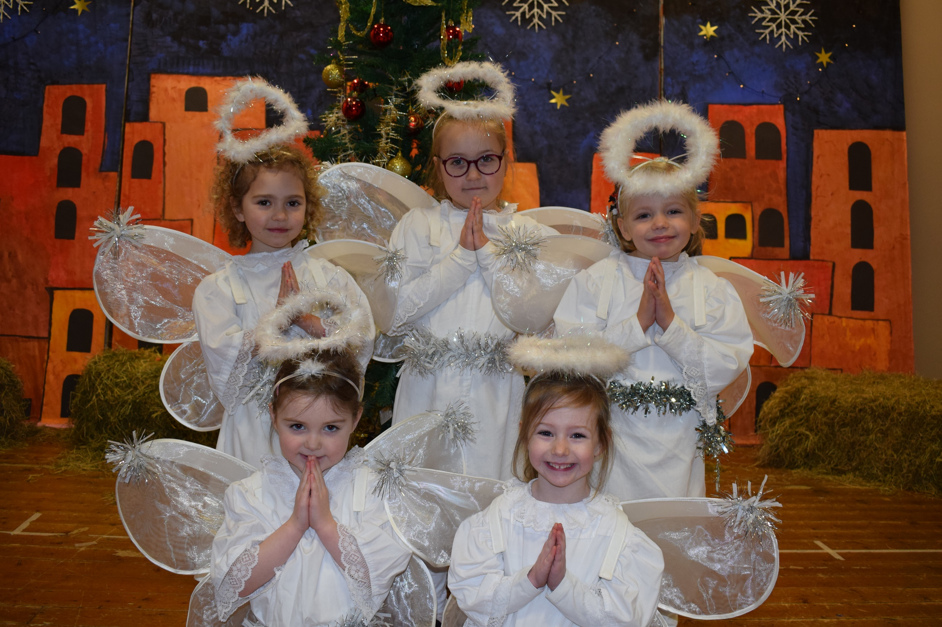
Angels
Charlotte, Anna, Jennifer, Amelia and Elsa

Slide 4
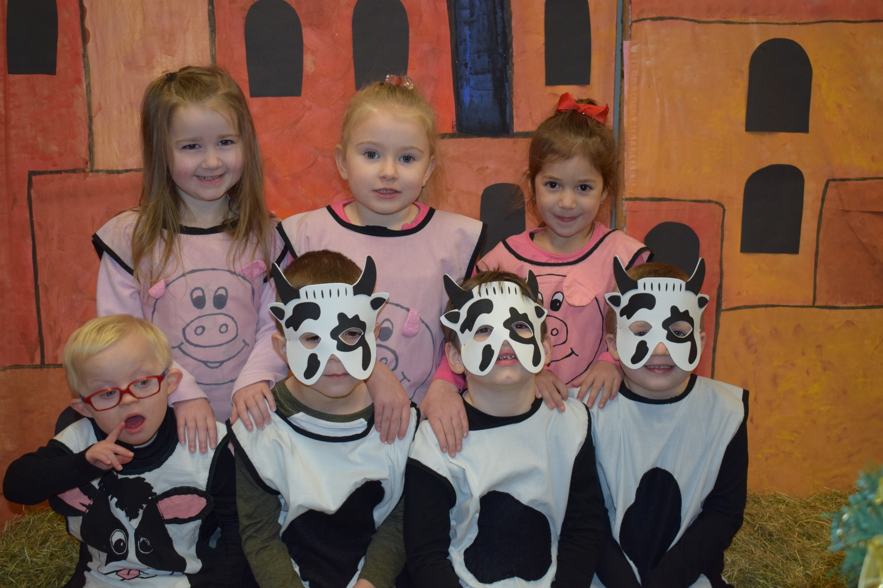
Stable Animals
Scott, Lucy, Filip, Bobbi-Leigh, Michael, Amira and James

Slide 5
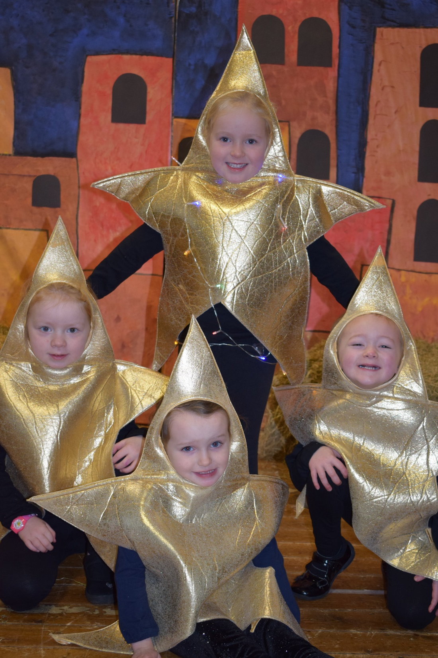
Stars
Dixie, Anna, Chloe and Jodie-Leigh

Slide 6
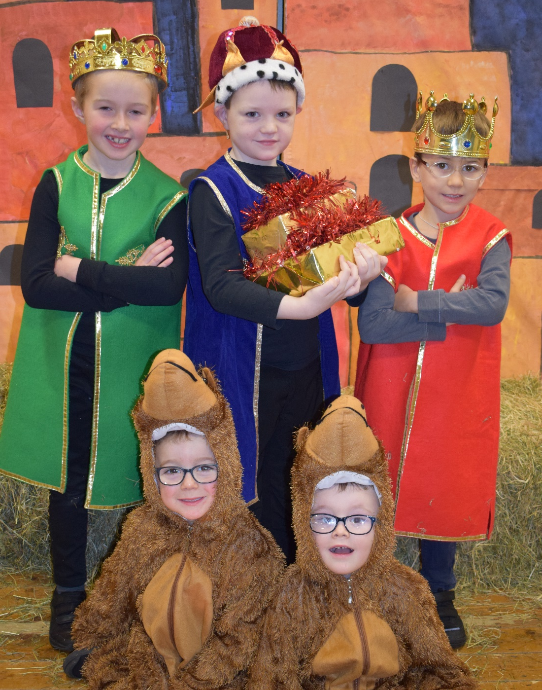
Wise Men & Camels
Mark, Lewis, George, Charlie and Finn

Slide 7
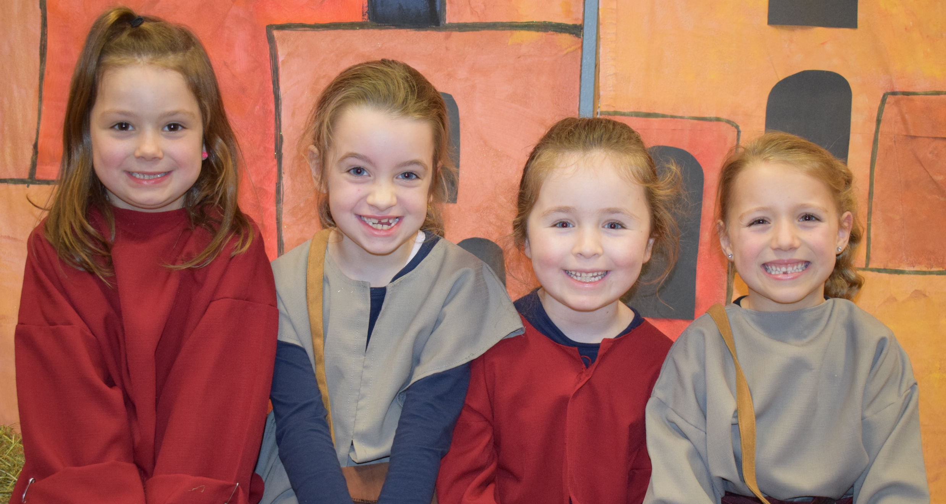
Innkeepers
Maddy, Megan, Bethany and Isla

Slide 8
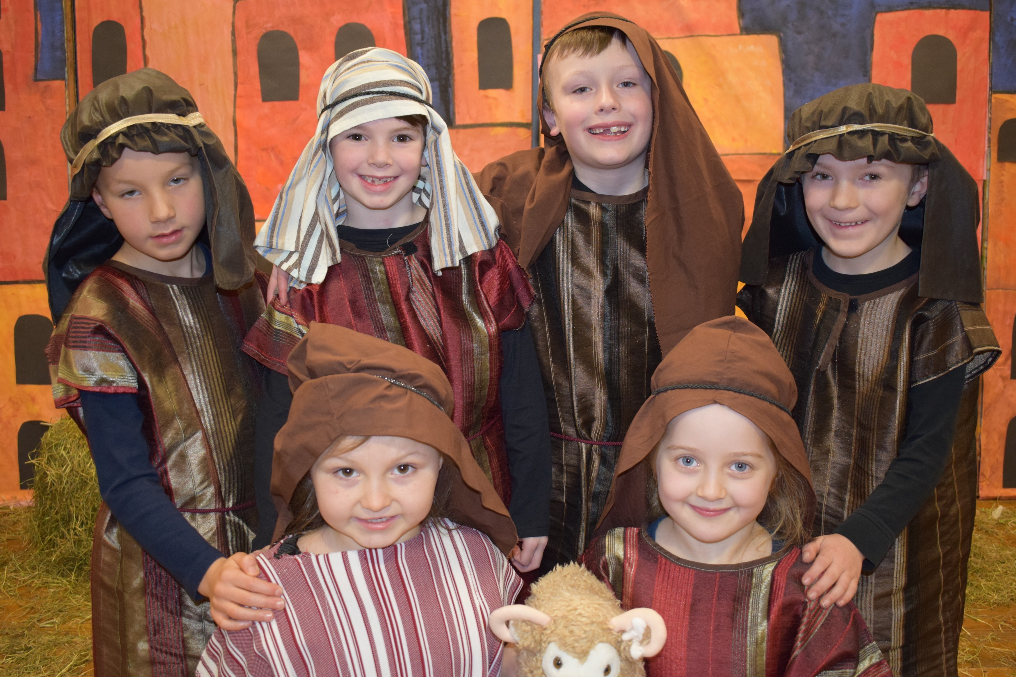
Shepherds
Joshua, Ben, Sam, Ben, Payton and Emily

Slide 9
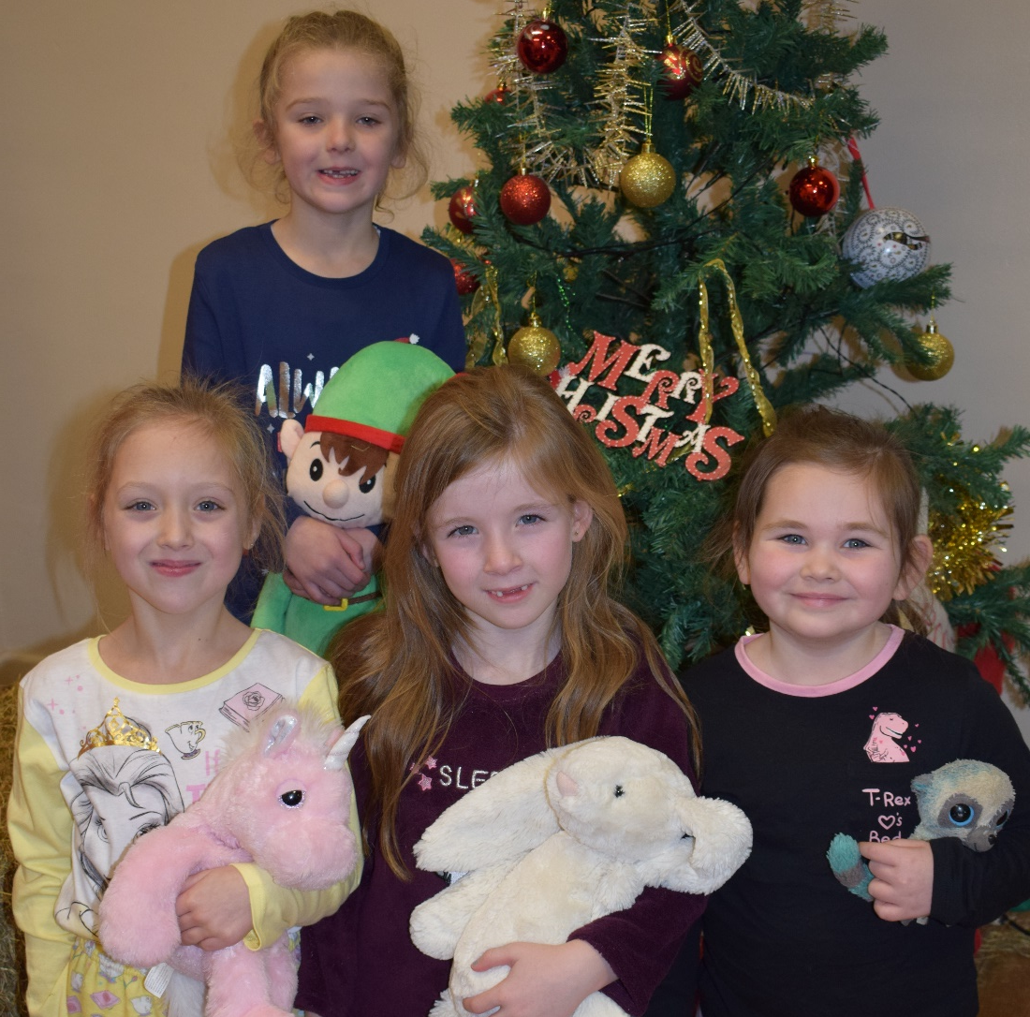
Christmas Children
Angelina, Leah, Jessie and Mia

Slide 10
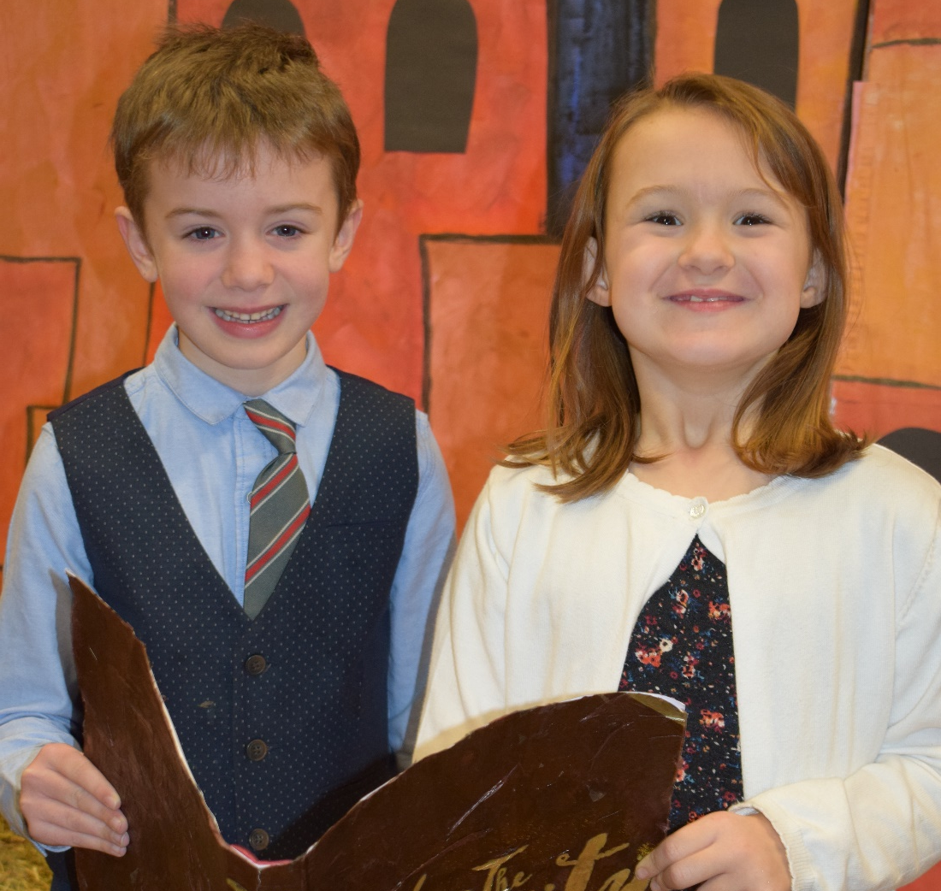
Dad & Mum
Michael and Evie

Slide 11
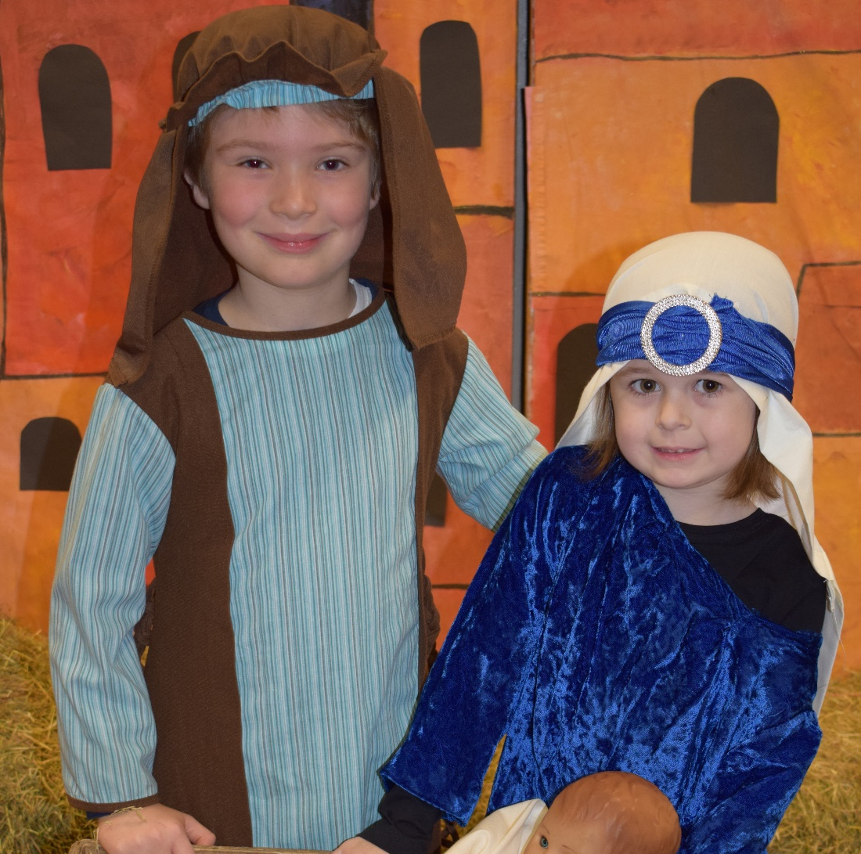
Joseph & Mary
Harry and Sarah

Slide 12
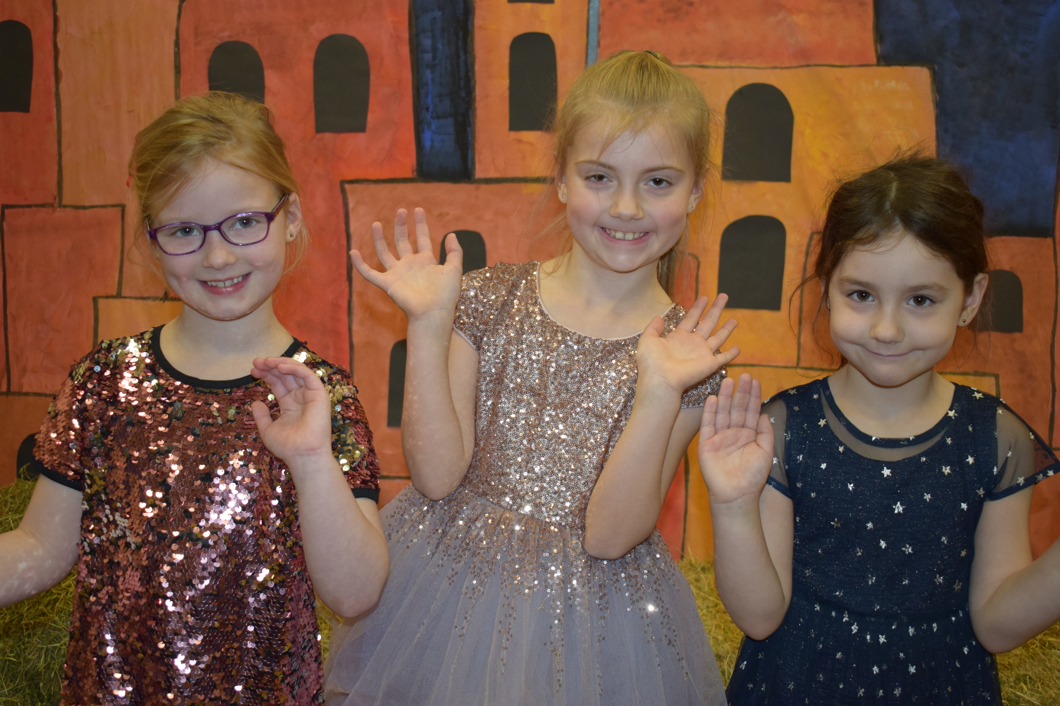
Bible Readers
Grace, Scarlett and Jessica

Slide 13
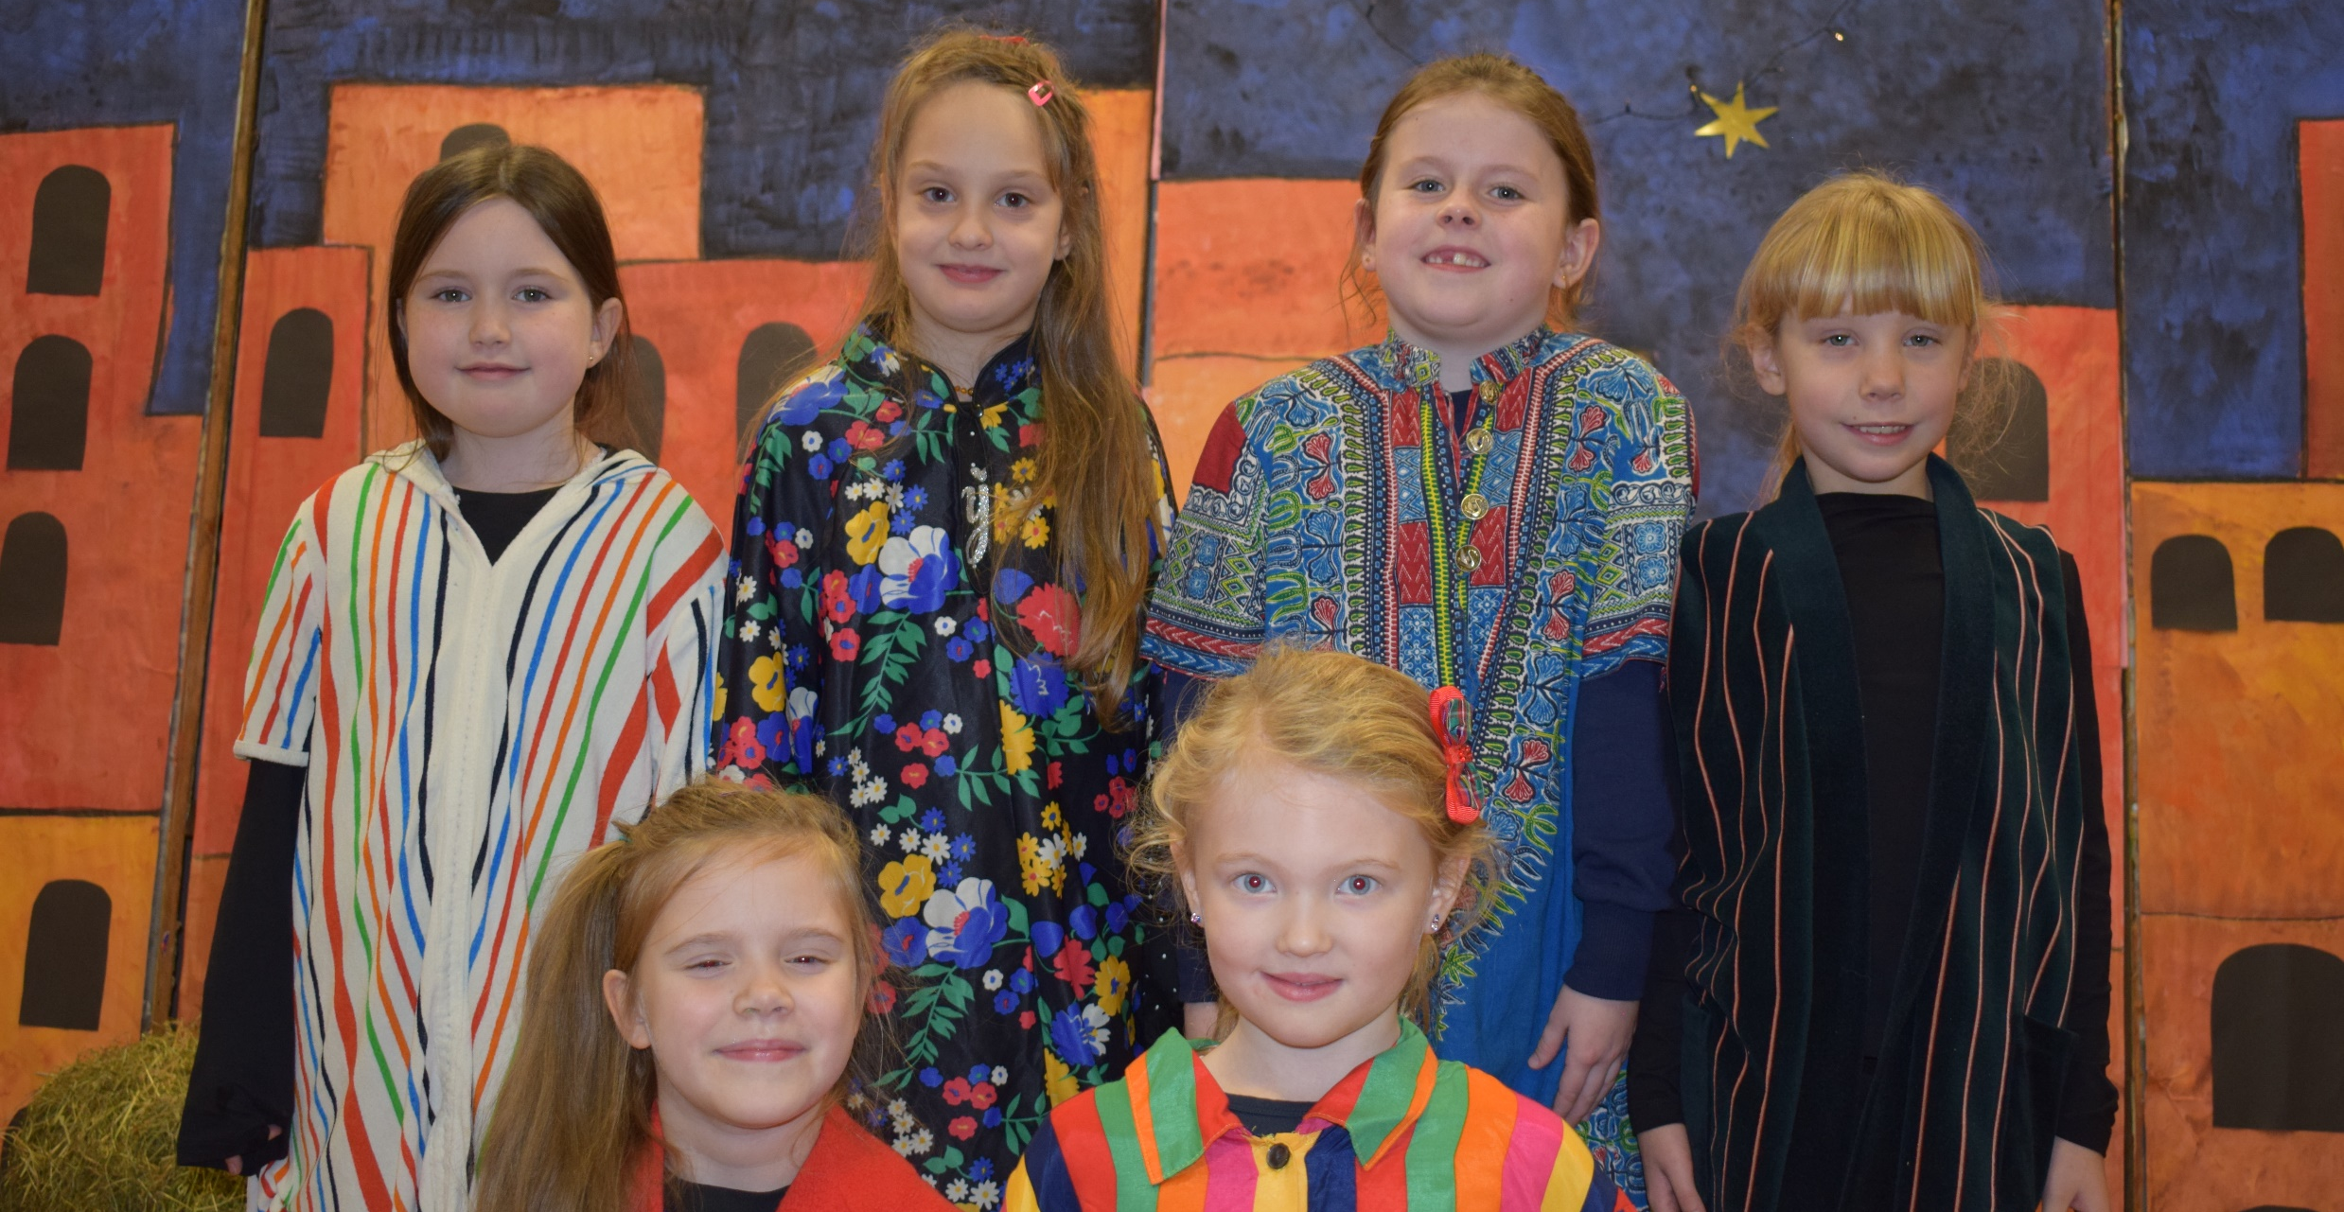
Town People
Mia, Csenge, Rihanna, Demi-Lee, Paulina and Lexie

Slide 14
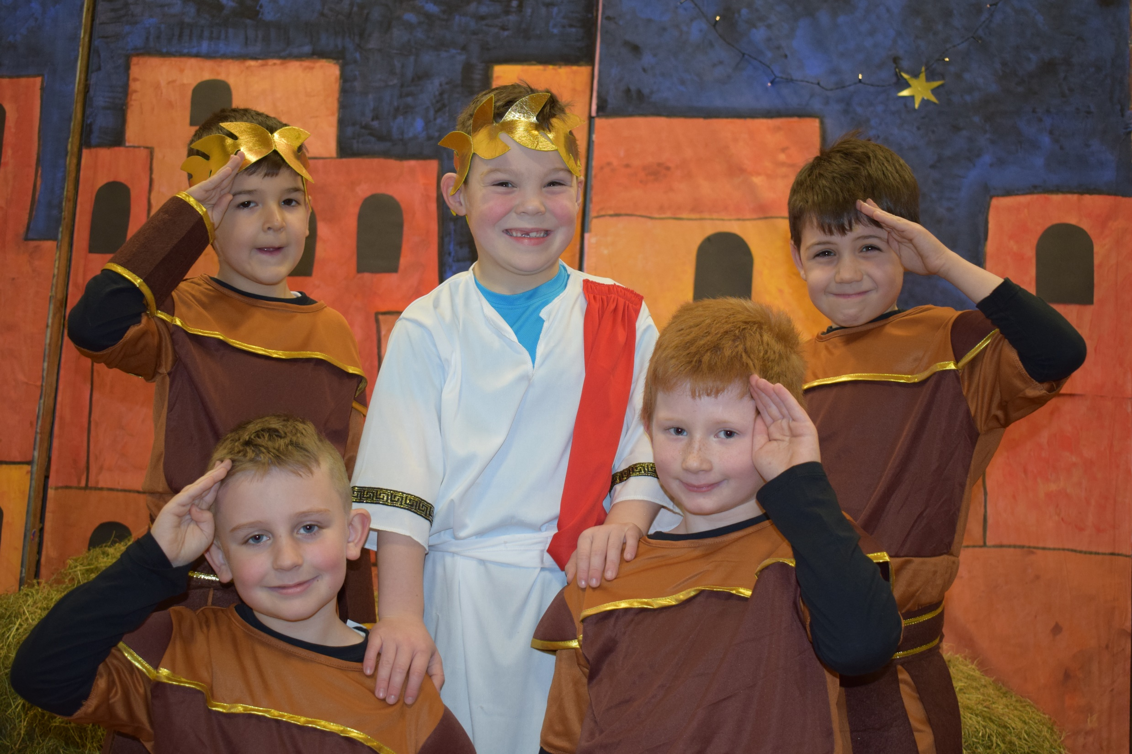
Herod & his Soldiers
Corey, Gabriel, Jack, Levi and Tilson

Slide 15
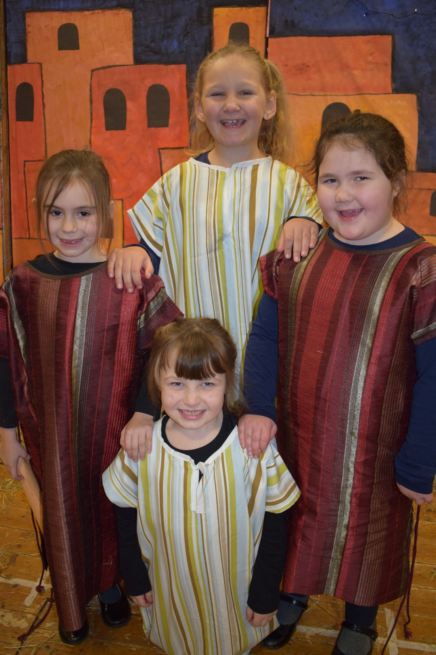
Census Takers
Lily, Zlata, Aliya, Leah and Cole

Slide 16
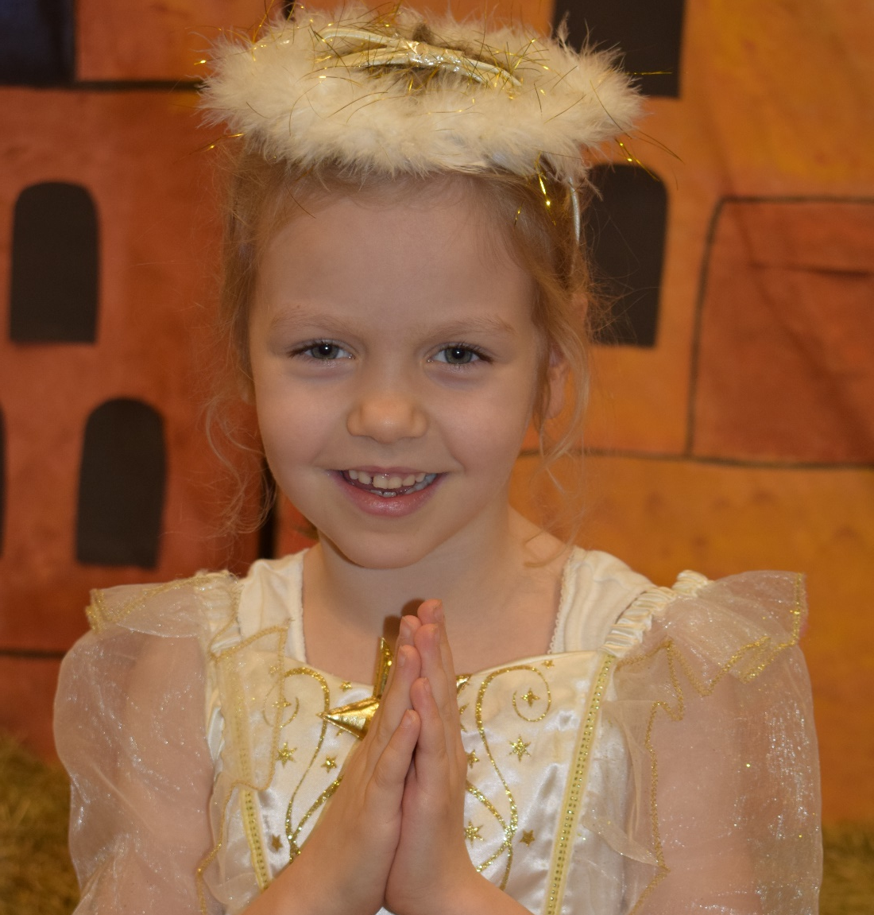
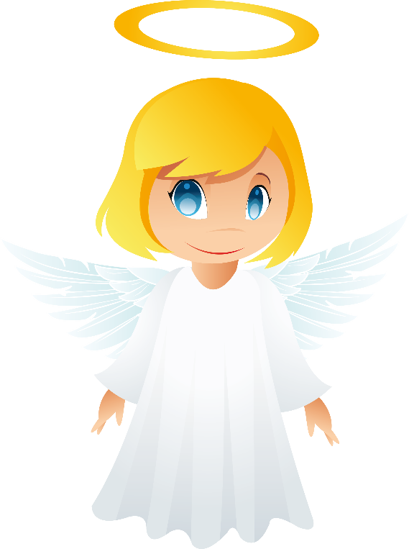
Angel Gabriel
Hollie

Slide 17
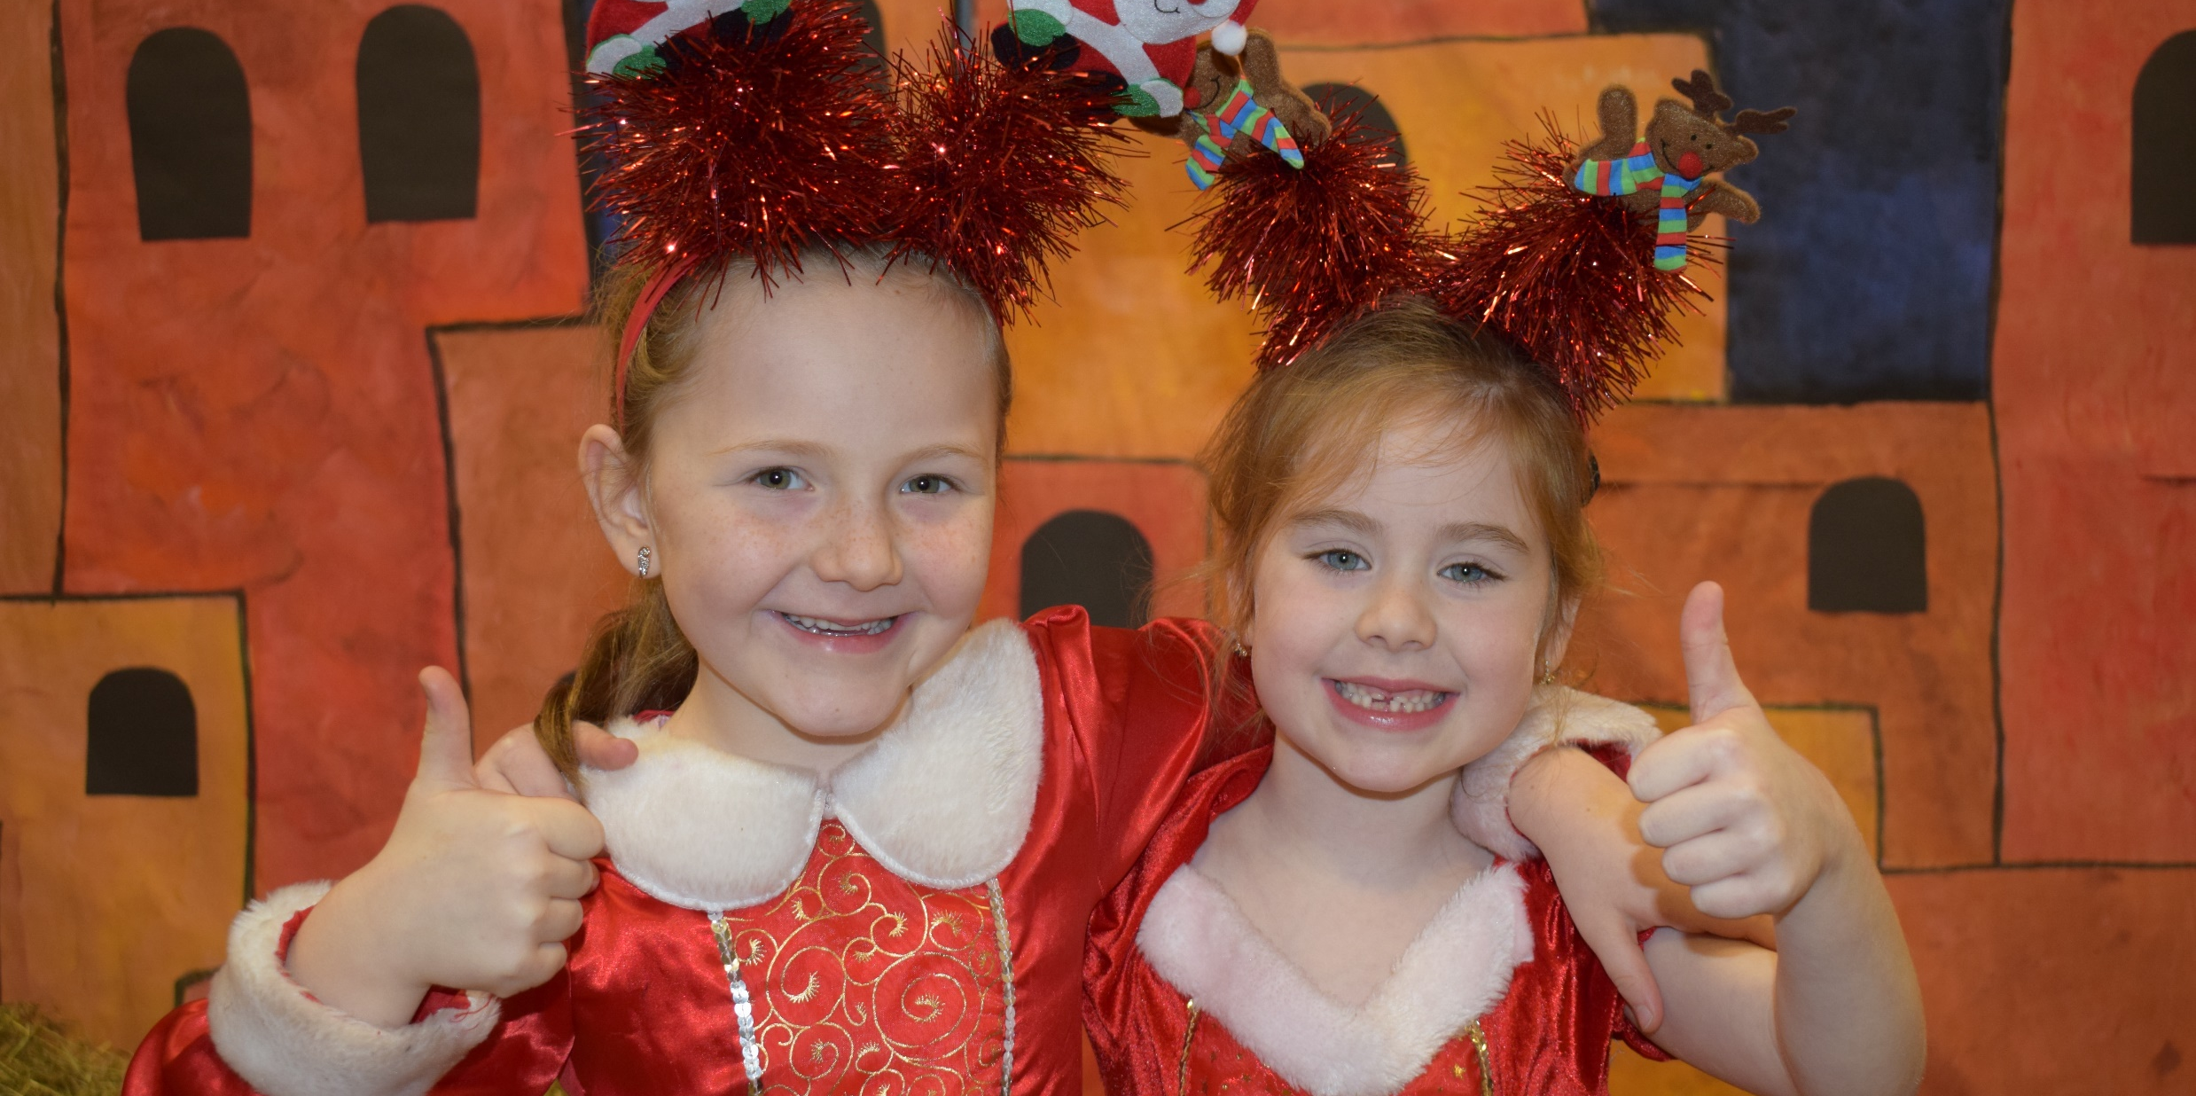
Comperes
Luca and Sarah

Slide 18
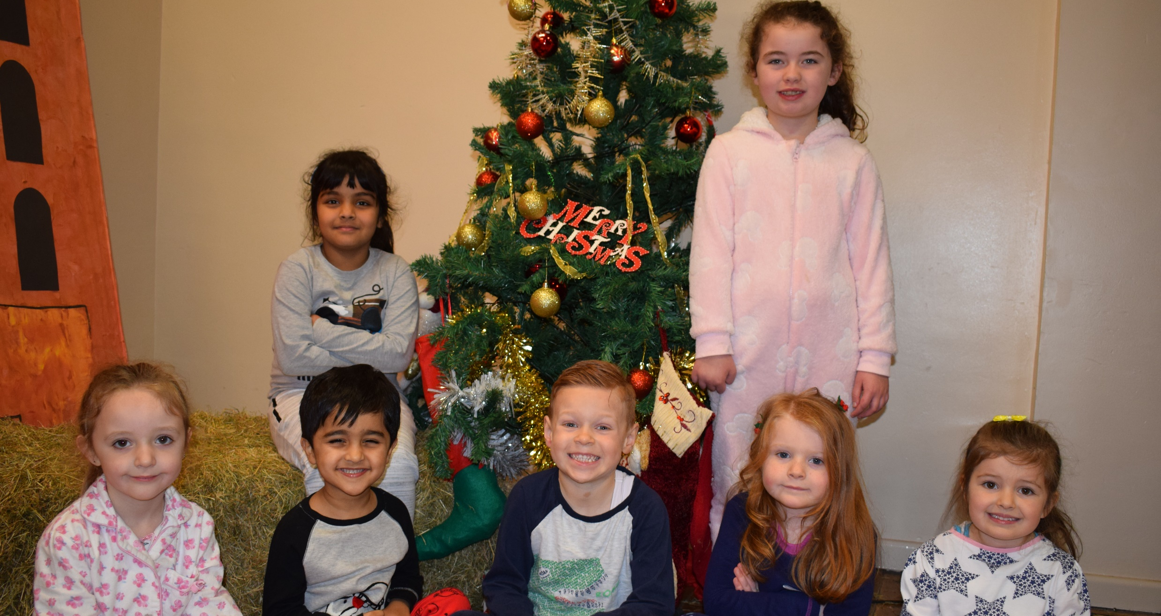
Christmas Eve Children
Lydia, Ayan, Ryan, Lena, Erin, Anusha and Cara

Slide 19
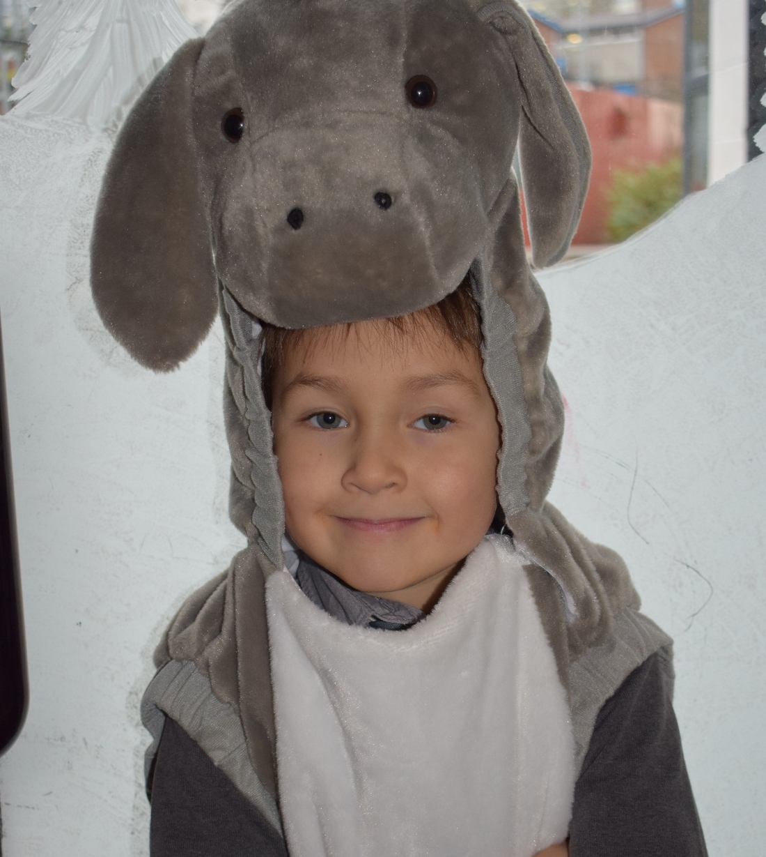
Donkey
John

Slide 20
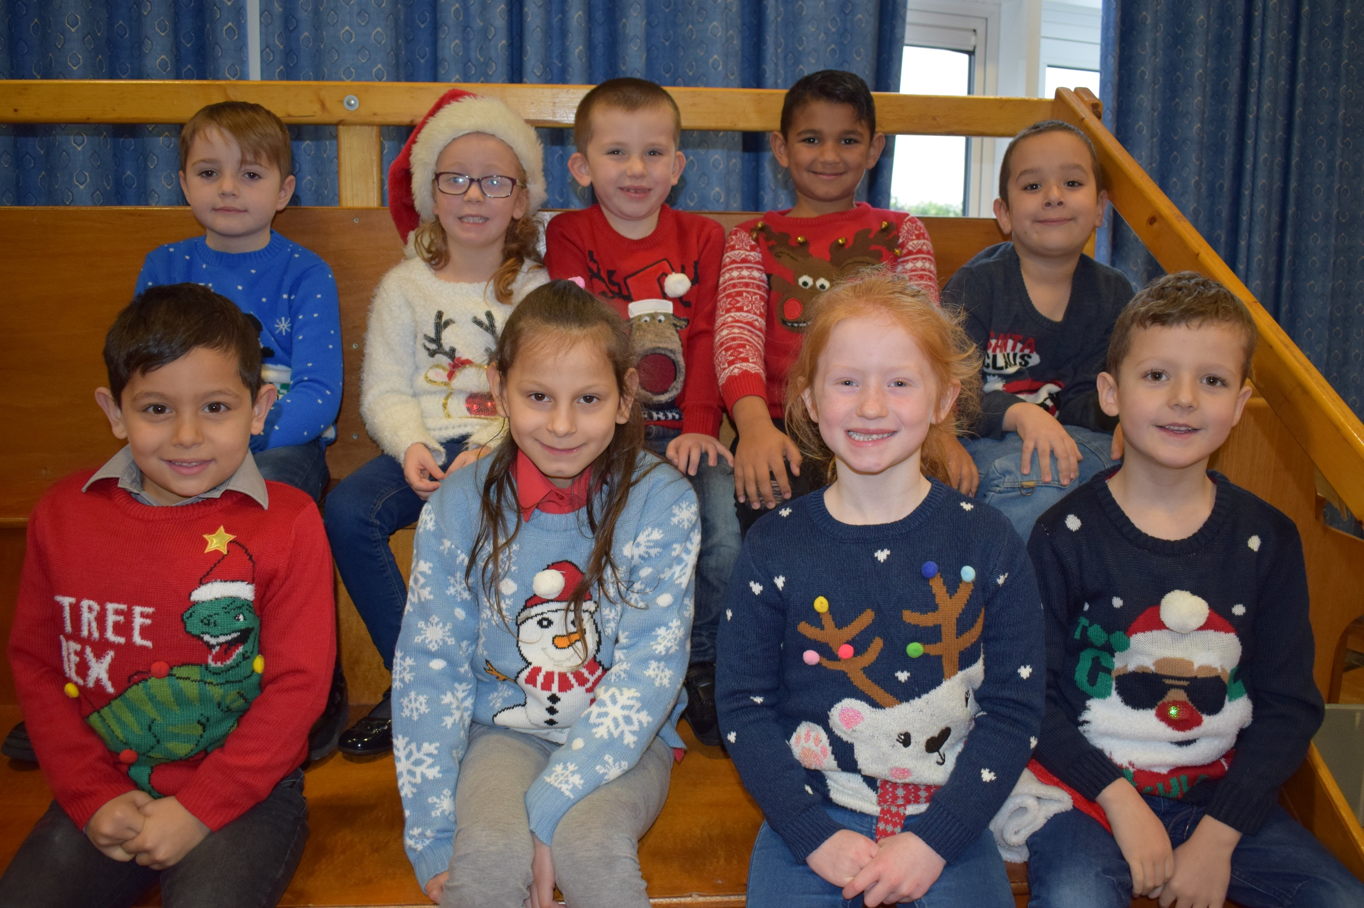
Year 2 Choir
James, Sophie, Mathew, Stanislav, Ali,
Lukas, Litta, Ashleigh and Henry

Slide 21
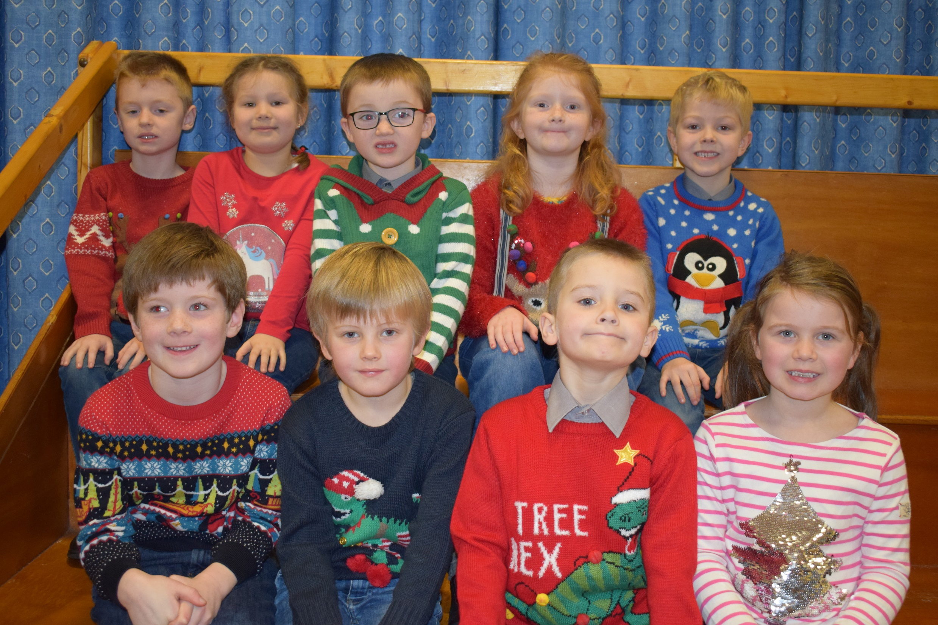
Year 2 Choir
Seth, Agatha, Scott, Katie-Leigh, Tom,
Tadgh, Jonah, Zackary and Bethany

Slide 22
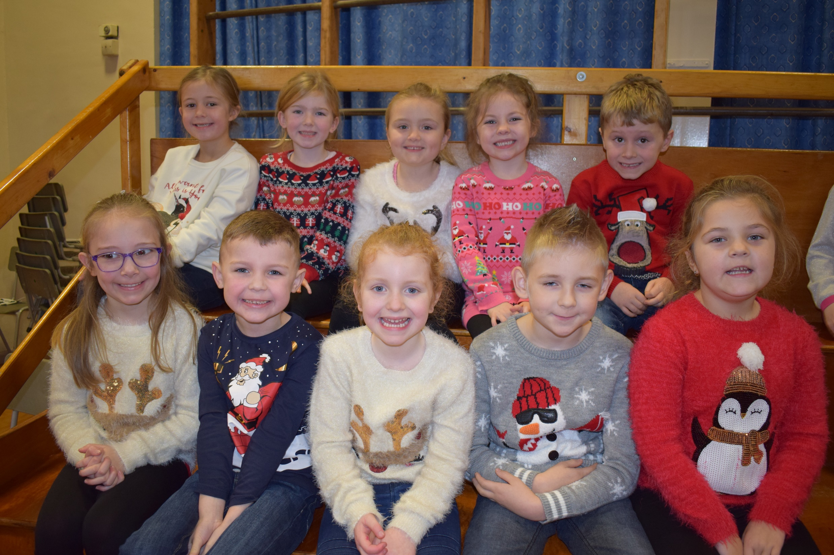
Year 2 Choir
Lily-Anne, Faye, Zarah, Skye, Zach,
Ellie, Oscar, Rose, Dawid and Emma

Slide 23
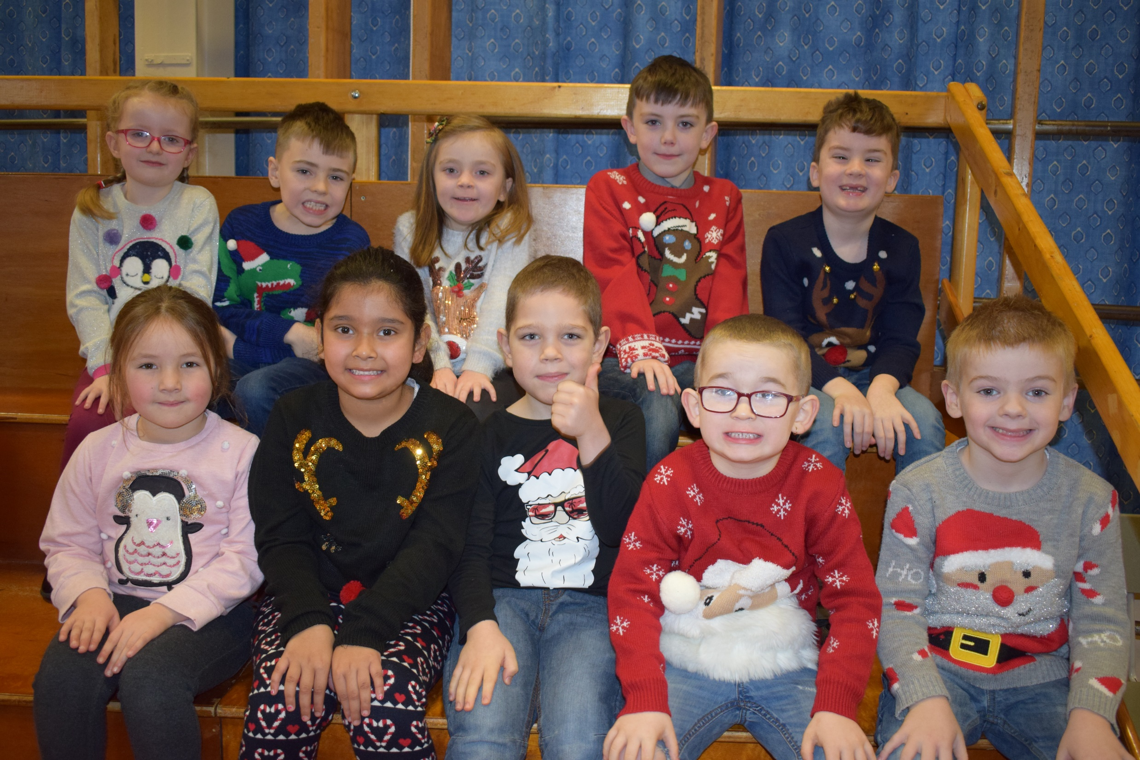
Year 2 Choir
Isabella, Caolan, Sophie, Tyler, Oliver,
Sophie, Ramezah, Krisztian, Jay and Andrew

Slide 24
Missing from photographs…
Leah, James, Vojteck

